Slide 1
Tree Species
(Binary Trees, Binary Search Trees)
EECS 233

Slide 2
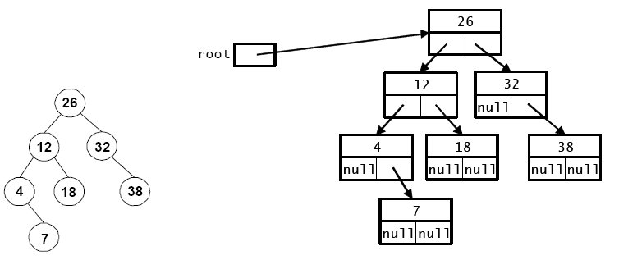
Previous Lecture
Binary Tree Representation in Java
  public class LinkedTree {
    private class Node {
      private int key;
      private String data;
      private Node left; // reference to left child
      private Node right; // reference to right child
      …
    }
    private Node root;
    …
  }

Slide 3
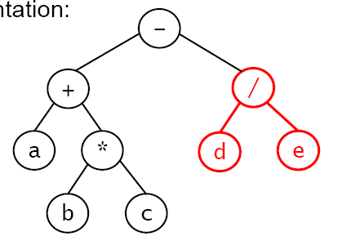
Binary Trees and Expressions
We’ll restrict ourselves to fully parenthesized expressions and to the following binary operators: +, –, *, /
  Example expression: ((a + (b * c)) – (d / e))
  Tree representation:
Leaf nodes are variables or constants; interior nodes are operators.
Because the operators are binary, either a node has two children or it has none.

Slide 4
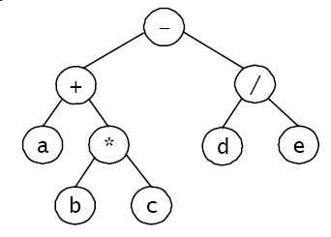
Traversing An Expression Tree
Inorder gives conventional infix expression.
  print ‘(’ before the recursive
  call on the left subtree
  print ‘)’ after the recursive
  call on the right subtree
  for tree at right: ((a + (b * c)) – (d / e))
  parenthesis to avoid ambiguity
Postorder gives the postfix expression.
  for tree above: a b c * + d e / –
Preorder gives functional notation.
  print ‘(’s and ‘)’s as for inorder
  for tree above: – ( + (a, *(b, c)), / (d, e)), or – + a * b c / d e

Slide 5
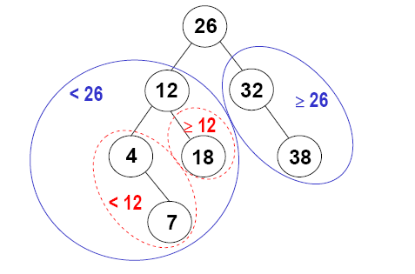
Binary Search Trees
Search-tree property: for each node k:
  all nodes in k’s left subtree are < k
  all nodes in k’s right subtree are >= k
Performing an inorder traversal of a binary search tree visits the nodes in sorted order.

Slide 6
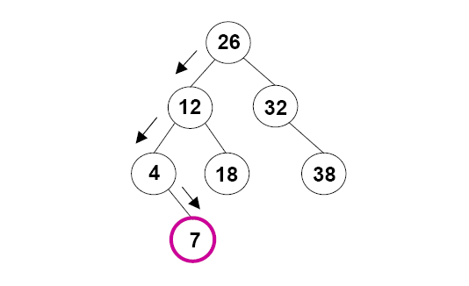
Searching An Item in A Binary Search Tree
Algorithm for searching for an item with a key k:
  if k == the root node’s key, you’re done
  else if k < the root node’s key, search the left subtree
  else search the right subtree
Example: search for 7
search for 30?

Slide 7
Implementing Search using Recursion
    private class Node {
      private int key;
      private String data;
      private Node left;
      private Node right;
      }
  public class LinkedTree {
    …
    private Node root;
    public String search(int key) {
      Node n = searchTree(root, key);
      return (n == null ? null : n.data);
    }
    private Node searchTree(Node root, int key) {
      //
      if (root == null)
        ?
      else if (key == root.key)
        ?
      else if (key < root.key)
        ?
      else
        ?
    }
  }
The search(int key) method makes the initial call of the recursive searchTree(Node root, int key) method, invoking it on the root of the entire tree.
return null;
return root
return searchTree(root.left, key);
return searchTree(root.right, key);

Slide 8
Implementing Search using Iteration
  public class LinkedTree {
    …
    private Node root;
    public String search(int key) {
      Node n = searchTree(root, key);
      return (n == null ? null : n.data);
    }
    private Node searchTree(Node root, int key) {
      Node trav = root;
      while (trav != null) {
        if (key == trav.key)
        return trav;
        else if (key < root.key)
        trav = trav.left;
        else
        trav = trav.right;
      }
      return null;
    }
  }

Slide 9
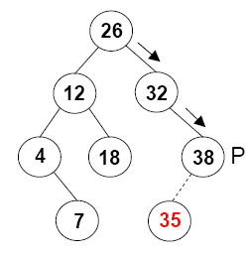
Inserting An Item in A Binary Search Tree
We want to insert an item whose key is k.
First, we find the node P that will be the parent of the new node:
  we traverse the tree as if we were searching for k, but we don’t stop if we find it – we continue until we can’t go any further
Next, we add the new node to the tree:
  if k < P’s key, make the node P’s left child
  else make the node P’s right child
Special case: if the tree is empty, make
the new node the root of the tree

Slide 10
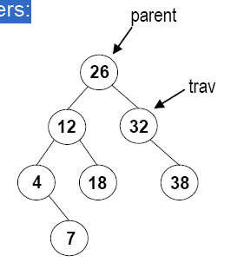
Implementing Insert
We'll use iteration rather than recursion.
Our method will use two references:
  trav: performs the traversal down to the point of insertion
  parent: stays one behind trav
  when we're done with the traversal:
    trav will be null;
    parent will point at the a leaf node that will be the parent of the new node

Slide 11
Iterative implementation
  public void insert(int key, String data) {
    // Find the parent of the new node.
    Node parent = null;
    Node trav = root;
    while (trav != null) {
      parent = trav;
      if (key < trav.key)
        trav = trav.left;
      else
        trav = trav.right;
    }
    // Insert the new node.
    if (parent == null) // the tree was empty
      ?
    else if (key < parent.key)
      ?
    else
      ?
  }
Insert 35?
root = new Node(key,data);
parent.left = new Node(key,data);
parent.right = new Node(key,data);

Slide 12
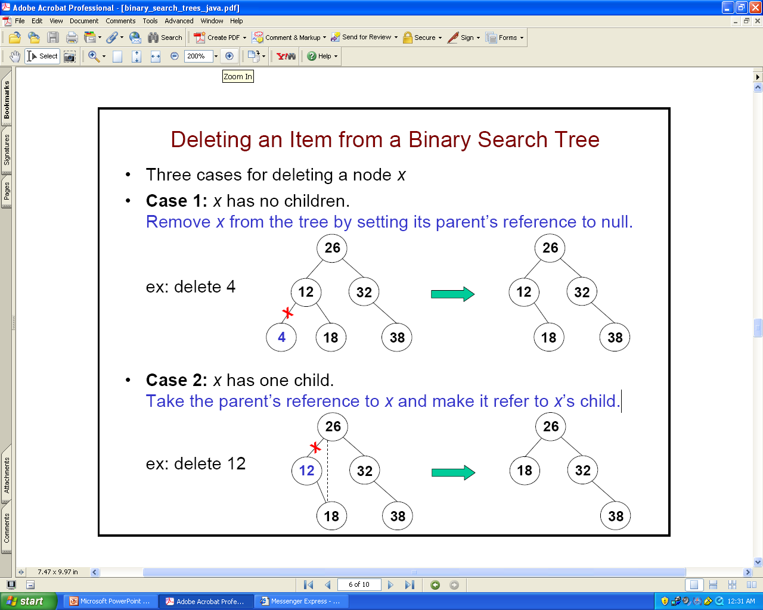
Deleting An Item from A Binary Search Tree
Three cases for deleting a node x
Case 1: x has no children.
  Remove x from the tree by setting its parent’s reference to null.
Case 2: x has one child.
  Take the parent’s reference to x and make it refer to x’s child.

Slide 13
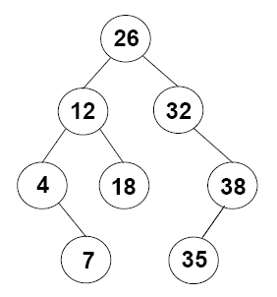
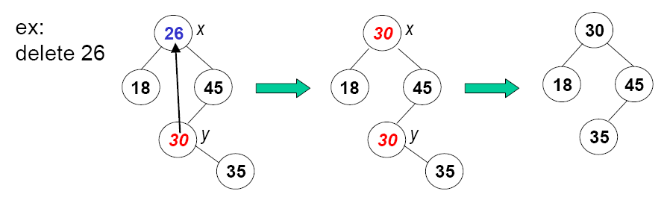
Deleting An Item from A Binary Search Tree
Case 3: x has two children
  we can't just delete x.
  instead, we replace x with a node from
  elsewhere in the tree, and we must
  choose the replacement carefully
Which node could replace?
  replace x with the smallest node in x’s right subtree—call it y.
  y will either be a leaf node or will have one right child.
  after copying y’s item into x, we delete y using case 1 or 2.

Slide 14
Implementing Delete
  public String delete(int key) {
    // Find the node and its parent.
    Node parent = null;
    Node trav = root;
    while (trav != null && trav.key != key) {
      parent = trav;
      if (key < trav.key)
        trav = trav.left;
      else
        trav = trav.right;
    }
    // Delete the node (if any) and return the removed item.
    if (trav == null) // no such key
      return null;
    else {
      String removedData = trav.data;
      deleteNode(trav, parent);
      return removedData;
    }
  }
This method uses a helper method to delete the node.

Slide 15
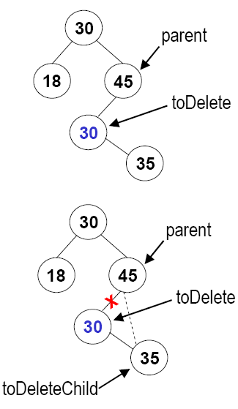
Implementing Delete
(Case 1 and 2)
private void deleteNode(Node toDelete, Node parent) {
  if (toDelete.left == null || toDelete.right == null) {
  // Cases 1 and 2
    Node toDeleteChild = null;
    if (toDelete.left != null)
      toDeleteChild = toDelete.left;
    else
      toDeleteChild = toDelete.right;
    // both Cases are included. In case 1 toDeleteChild==null
    if (toDelete == root)
      ?
    else if (toDelete.key < parent.key)
      ?
    else
      ?
    }
  } else { // case 3
    …
  }
Root
4
6
root = toDeleteChild;
5
parent.left = toDeleteChild;
parent.right = toDeleteChild;

Slide 16
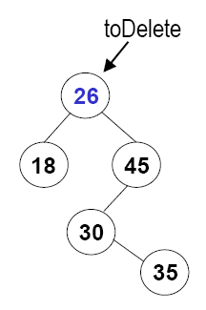
Implementing Delete
(Case 3)
private void deleteNode(Node toDelete, Node parent) {
  if (toDelete.left == null || toDelete.right == null) { // case 1 and 2
    …
  } else { // case 3
    // Get the smallest item in the right subtree.
    Node replacementParent = toDelete;
    Node replacement = toDelete.right;
    ?
    // Replace toDelete's key and data
    “toDelete.key = replacement.key;”
    “toDelete.data = replacement.data;”
    // Recursively delete the replacement item's old node.
    deleteNode(replacement, replacementParent);
  }
while (replacement.left != null) {
replacementParent = replacement;
replacement = replacement.left;
}
replacement

Slide 17
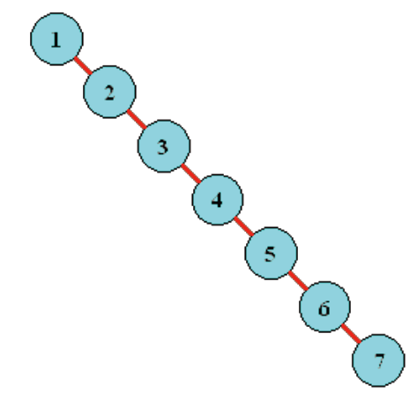
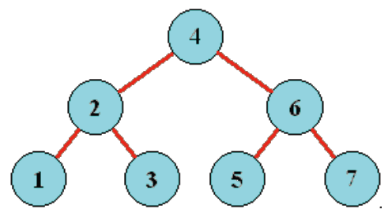
Efficiency of Binary Search Tree
The three key operations (search, insert, and delete) all have the same time complexity.
Insert and delete both involve a path traversal from root to a node with less than one child, plus a constant number of additional operations
Time complexity of searching a binary search tree:
  best case: O(1)
  worst case: O(h), where h is the height of the tree
  average case: O(h)
What is the height of a tree containing n items?
  It depends!

Slide 18
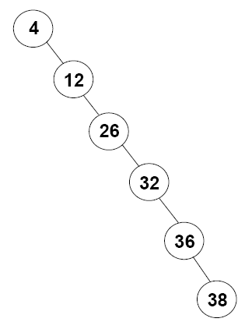
Balanced Binary Search Tree
If a tree is not balanced, for example, an extreme case:
  height = n – 1, and
  worst-case time complexity = O(n)
A tree is balanced if, for each node,
the node’s subtrees
  have heights that differ by at most 1
  For a balanced tree with n nodes:
    height = O(log₂n):
      1 node at level 0
      2 nodes at level 1 …
      2^{L} nodes at level L …
    worst-case time complexity =O(log₂n)

Slide 19
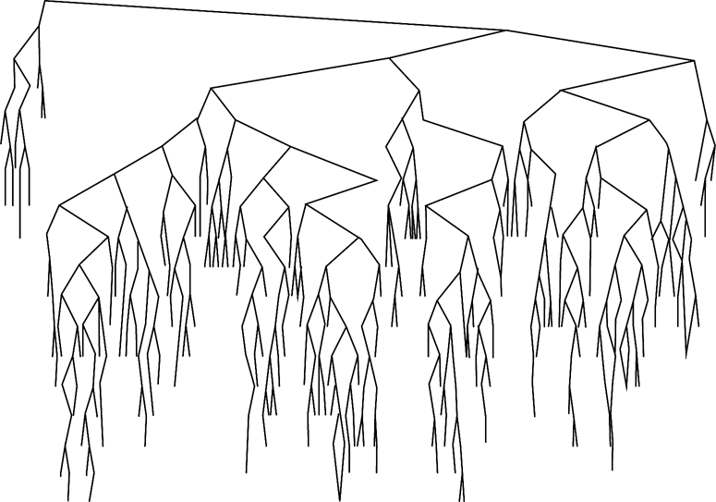
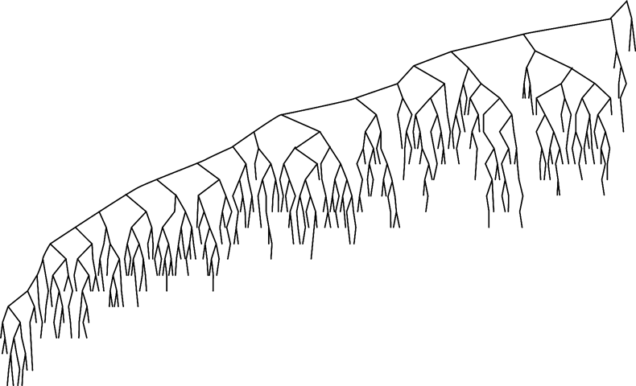
Balance of A Randomly Generated Tree
Same tree after a large
number of random inserts/removes
Random binary search tree
Random insertion – anywhere; random removal – from the right subtree

Slide 20
Question
Is it possible to construct the BT when its
  Preorder traversal is given
  Inorder traversal is given
  Both preorder and inorder traversals are given
Example:
  Preorder: 3 8 9 2 7
  Inorder: 8 3 2 9 7

Slide 21
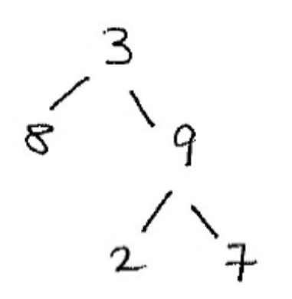
Question
Is it possible to construct the BT when its
  Preorder traversal is given
  Inorder traversal is given
  Both preorder and inorder traversals are given
Example:
  Preorder: 3 8 9 2 7
  Inorder: 8 3 2 9 7

